Slide 1
North Carolina Benefits
Crystal Miller, Mecklenburg county veteran services

Slide 2
Thank you does not begin to make up for your sacrifice. However, I thank you all for being here today, for standing by each other, and for honoring our country with your service.

Slide 3
Benefits for Service Members, Veterans, and their Families
Service Members
Honorably Discharged Veterans
Dependent Family Members
Advocacy
Veteran Service Officers
Veteran Service Centers
County Veteran Service Offices
https://www.milvets.nc.gov/

Slide 4
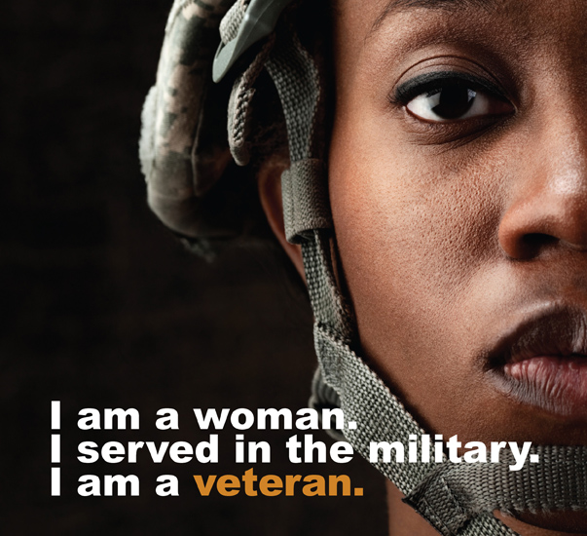
Benefits for Service Members, Veterans, and their Families
North Carolina has a devoted team of professionals committed to ensuring that all those who served –and their loved ones –are made aware of and maximize all the benefits and resources available. This team, made up of state and county VSOs, has an established relationship with the Federal Department of Veterans Affairs.
Services are provided free of charge and access to current federal, state, and local veterans’ programs, entitlements, and referral services are available at a Veterans Service Office near you.
https://www.milvets.nc.gov/benefits-services/benefits-claims

Slide 5
Click on your county for both the state and local VSO

Slide 6
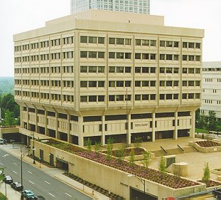
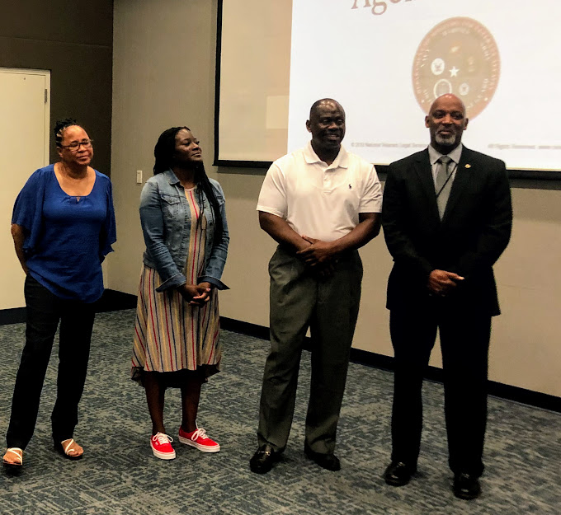
State Service Office (SSO)
The VSOs co-located at the US Department of Veterans Affairs (USDVA) federal building in Winston Salem, NC represent all veterans, who have named NCDMVA as their authorized service organization, at personal hearings and/or appeals.
Hearings include attempting to prevent reductions in ratings, higher level reviews of denied claims and/or claims that were awarded an incorrect rating. These staff also represent claimants at Board of Veterans Appeals hearings.
They are also essential to the state’s Scholarship program.

Slide 7
North Carolina State Veterans Cemeteries
State Cemeteries
Jacksonville
Spring Lake
Black Mountain
Goldsboro
https://www.milvets.nc.gov/services/nc-veterans-cemetery-program

Slide 8
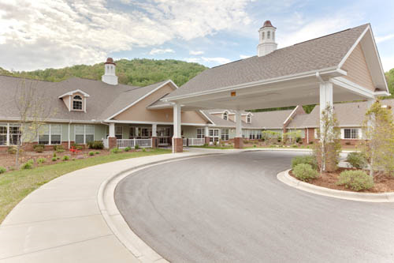
North Carolina State Veterans Home
Fayetteville
Salisbury
Black Mountain
Kinston
Kernersville
Grand Opening 2023
Raleigh
Planning Phase
Skilled level care facilities only

Slide 9
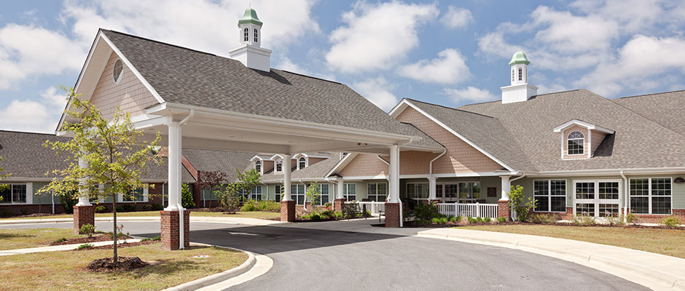
North Carolina State Veterans Home Eligibility
Each of NCDMVA’s homes has a Veteran Service Officer. Utilizing the link below, you may contact the admissions coordinator for eligibility and application information.
https://www.milvets.nc.gov/benefits-services/nc-state-veterans-homes-skilled-nursing-care

Slide 10
NC Scholarship for Children of Wartime Veterans
Veteran must have joined the service from NC
Child must be under the age of 25
For more information visit: https://www.milvets.nc.gov/services/scholarships
To request an account so that application may be completed please visit:
https://scholarships.milvets.nc.gov/Account/Login.aspx and click on Request an account

Slide 11
Employment
“It shall be the policy of the State of North Carolina that, in appreciation for their service to this State and this country during a period of war, and in recognition of the time and advantage lost toward the pursuit of a civilian career, veterans shall be granted preference in employment with every State department, agency, and institution. “ ~NCGS 126-80, Article 13
https://www.milvets.nc.gov/services/employment
https://www.nccommerce.com/jobs-training/resources-job-seekers/veterans-seeking-jobs-north-carolina

Slide 12
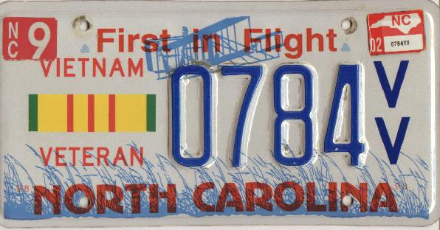
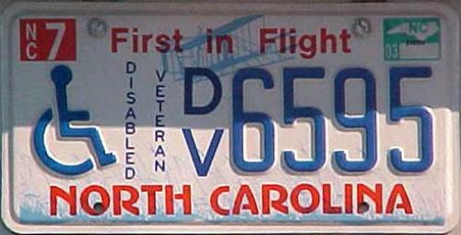
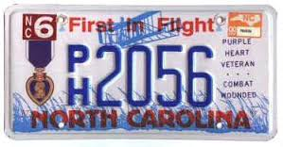
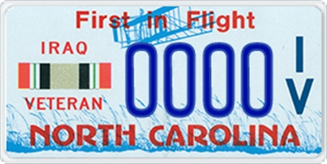
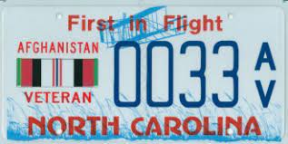
Military and Veteran License Plates
N.C. Department of Motor Vehicles provides a variety of automotive license tags for active-duty military, veterans organizations, active reserve, national guard, military award recipients, and disabled veterans.
Military/Veterans Registration Plate Application is located @:
https://www.ncdot.gov/dmv/downloads/Documents/MVR-33A.pdf#search=MILITARY%20AND%20VETERAN%20PLATES
https://www.milvets.nc.gov/services/military-and-veteran-license-plates

Slide 13
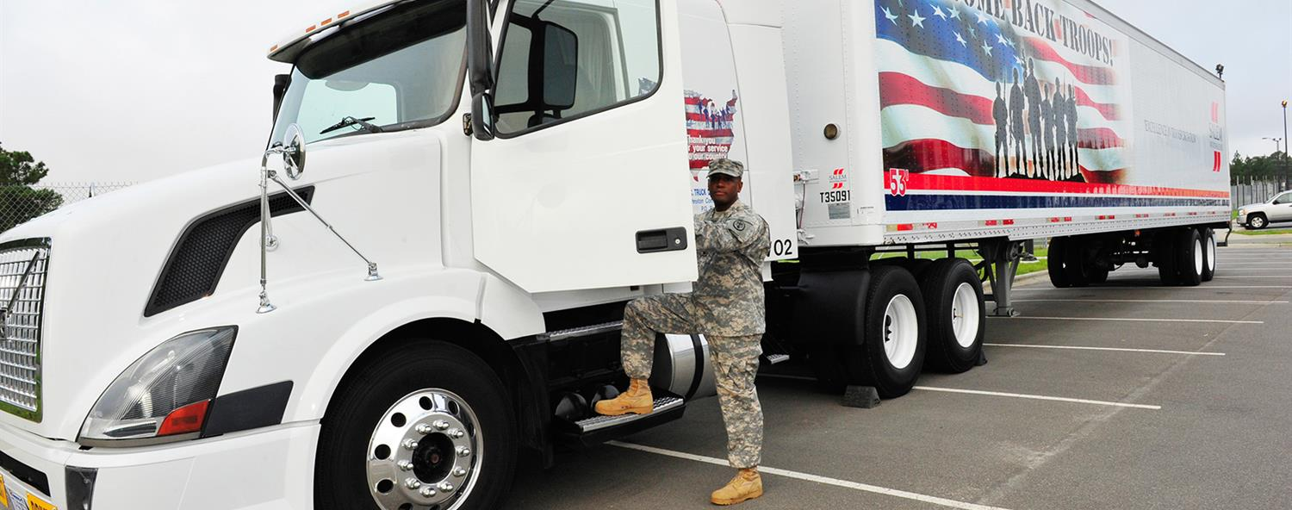
Division of Motor Vehicles: Services for Military Personnel
The N.C. Division of Motor Vehicles offers current and retired personnel of the U.S. Armed forces convenient options for renewing vehicle registrations, driver licenses as well as active-duty military and veteran designations.
Learn more:
Driver license renewal
Title & vehicle registration
Emissions & safety inspections​
Commercial driver license skills waiver
'VETERAN’ driver license designation
Last updated Jun. 1, 2020
https://www.ncdot.gov/dmv/offices-services/military/Pages/default.aspx

Slide 14
Hunting and Fishing
All 50% service-connected disabled veterans and those disabled in receipt of non service-connected pension are entitled to a lifetime basic hunting and fishing license.
Disabled Veteran Fishing Only Licenses
Inland Fishing – Statewide inland fishing. Includes fishing in designated Public Mountain Trout Waters, fishing in trout waters on game lands, and fishing in joint waters. It does not include fishing in coastal waters. $11
Coastal Recreational Fishing – Authorizes fishing in coastal and joint waters. It does not authorize fishing in inland waters. $11
https://www.ncwildlife.org/Portals/0/License/Documents/DisabledVetApplication.pdf
Application and Certification located at the link above:

Slide 15
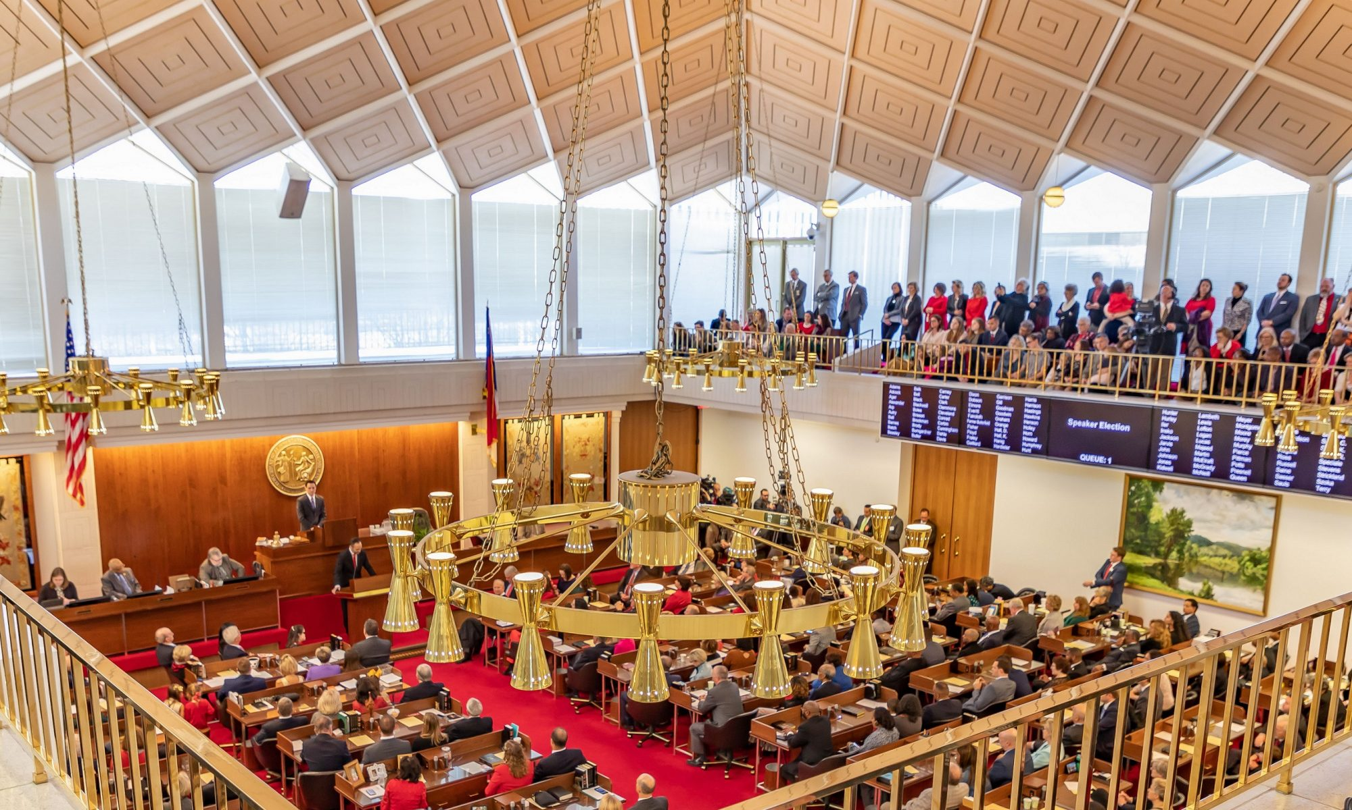
HOUSE BILL 83: Eliminate Income Tax for Military Retirees.
OVERVIEW: House Bill 83 would exempt the following from state income taxation:
Military retirement pay received by a retired member of the armed forces of the united states who served at least 20 years or was medically retired.
Payments from the survivor benefit plan to a beneficiary of a retired member of the armed forces of the united states who served at least 20 years or was medically retired.
House Bill 83 has PASSED
House Passed June 16th 2021
https://dashboard.ncleg.gov/api/Services/BillSummary/2021/H83-SMBA-21(e3)-v-2

Slide 16
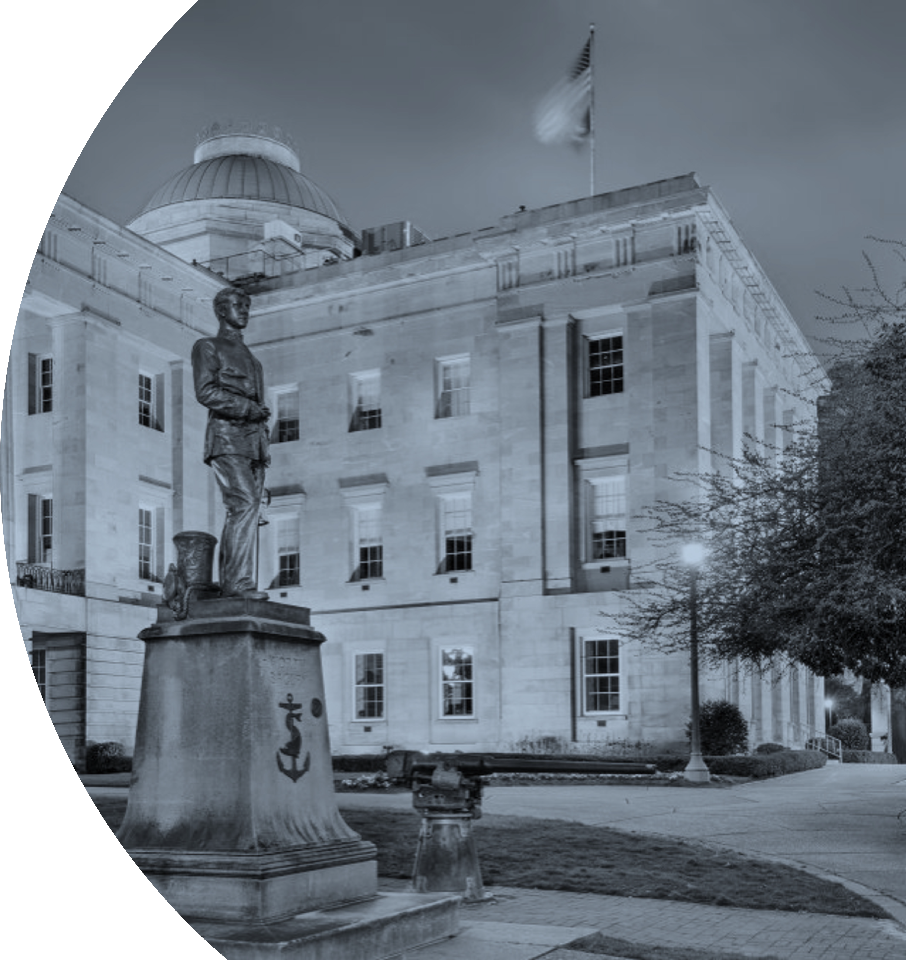
NCGWG.ORG
NCGWG.ORG

Slide 17
The North Carolina Governors Working Group
is an initiative to provide a seamless network of resources for service members, veterans, and their families(SMVF) across North Carolina by convening leading providers, government leaders, policy makers, and veteran organization leaders, on a Monthly/Quarterly/Annual basis to:
Map the trends, driving forces, and emerging issues impacting SMVF stability and quality of life while advocating for service along a continuum of facilitated and intentional intervention that could move them towards successful outcomes.
Develop strategies to help VSOs, state and federal agencies, and other key partners work in more collective, coordinated ways to successfully prepare for the future needs of SMVF.
Advance the Statewide network as a working model for integrating services for our state’s SMVF across organizations, platforms, and regions.

Slide 18
Background & Operation
A Common Agenda
Shared Measurement
Mutually Reinforcing Activities
Continuous communication
The identification and removal of barriers systemic to veteran health and wellness.

Slide 19
Our veteran services include:
Benefits Navigation, Clothing & Household Goods, Childcare, Education, Employment Entrepreneurship, Food Assistance, Health, Housing & Shelter, Income Support, Individual & Family Support, Legal, Mental/Behavioral Health, Money Management, Physical Health, Social Enrichment, Spiritual Enrichment, Sports & Recreation, Substance Use, Transportation, Utilities, and Wellness.

Slide 21
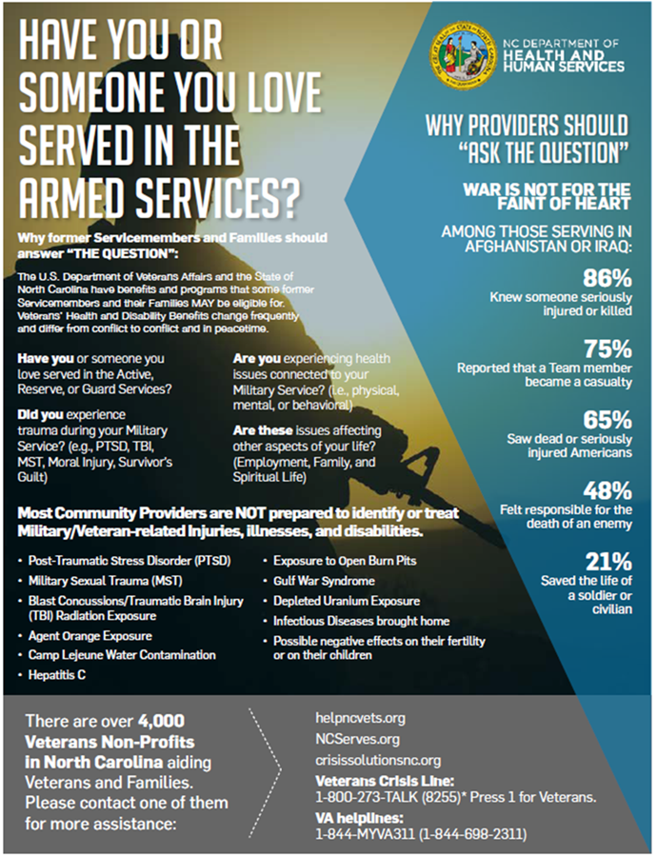
Have you or someone you love served in the armed forces?
https://ncgwg.org/
Click on the Governor’s Challenge to Prevent Suicide Among Service Members, Veterans, and their Families link to learn more about the resources available to the community. Please join us in the challenge.

Slide 22
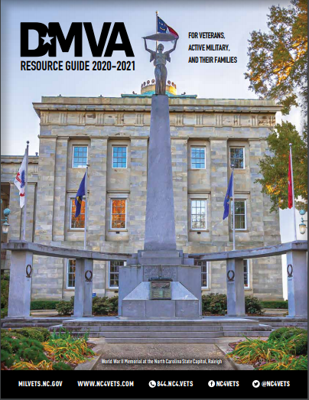
DMVA Resource
Guide
https://files.nc.gov/ncdmva/documents/files/dmva_resource_guide-2020.pdf

Slide 23
GWG Benefits Subcommittee Mission Statement:
Transform the lives of North Carolina service members, veterans, and their families by advocating for benefits meeting their needs through advocacy and coordinated action.
Advocate for incentivized legislation that meets the needs of service members, veterans, and their families.
Increased benefits utilization through statewide coordinated action and outreach.

Slide 24
Initial Goals
Recruit members to your sub-committee.
Meet bi-monthly.
Develop educational materials associated with your sub-committee focus.
Develop/ coordinate programs that are supporting your sub-committee focus
Each VSO office (State and County) have letters on hand for veterans to fill in the blanks and send to their representatives.
Develop metrics to define and measure the activities that are supporting your sub-committee
Coordinate with other sub-committees for "crossover" subject matter.

Slide 25
VA/SAMHSA Governor’s Challenge to Prevent Suicide Among Service Members, Veterans, and their Families
SAMHSA has partnered with the United States Department of Veterans Affairs (VA) to bring the Governor’s and Mayor’s Challenges to Prevent Suicide Among Service Members, Veterans, and their Families (SMVF) to states, territories, and communities across the Nation. For the Governor’s Challenge, 52 states and territories are currently taking part in the challenge and are working to develop and implement state-wide suicide prevention best practices for SMVF, using a public health approach.

Slide 26
