Slide 1

Department of Veterans Affairs, Mid-Atlantic Healthcare Network, VISN 6
Women Veteran Healthcare and Programs: Services and Benefits You’ve Earned!
Presented by: Shenekia Williams-Johnson, VISN 6 Lead Women Veterans Program Manager

Slide 2

Comprehensive Healthcare
Complete primary care and gender specific care from one provider
  Women’s Health PACT Teams
    A primary care team designed to meet the gender-specific needs of women Veterans
    Provides general primary care and basic reproductive care
    Integrated mental health
    Chaperones for exams and certain procedures
    Coordinates maternity care
  Acute and chronic illness
  Preventive services – including cervical and breast cancer screenings
  Integrated Mental Health services
  Coordination of care
  Chaperones for exams and certain procedures
Screening and Diagnostics
  Mammography - 3D Imaging
  Breast MRI and Ultrasound

Slide 3

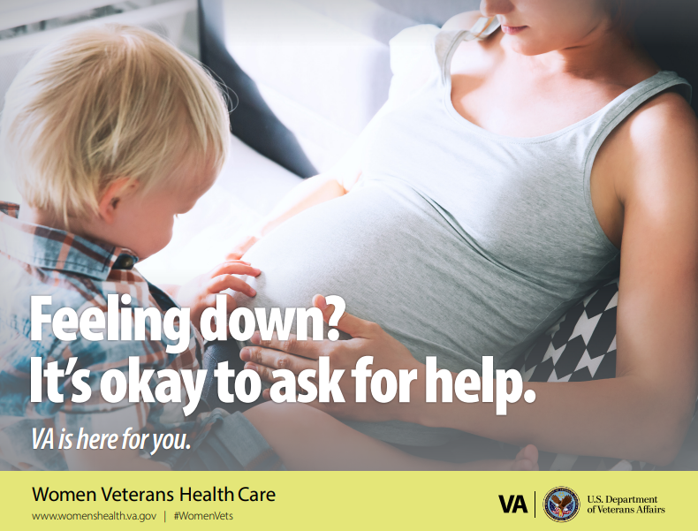
Reproductive Health: What VA Offers
Contraception
Preconception Care
Maternity Care Coordination – up to 1-year post-partum
Newborn care for up to 7 days
Lactation Specialists
Pregnancy Options Counseling, Care and Services
Menopause management
Gynecological surgery and non-surgical interventions
Healthy aging through the life cycle
Infertility Services
In Vitro fertilization is a benefit for seriously injured Veterans and their Spouses:
    Must have a service-connected condition that caused the infertility
    Must be legally married
    More information is available from VA providers or from the Women Veteran Program manager (WVPM)

Slide 4

Prosthetic Equipment for Women
Prosthetic & Sensory Aids Service (PSAS) provides comprehensive support to optimize health and independence of the Veteran
General eligibility for prosthetic services/items applies to Veterans who are:
  Enrolled in the VA healthcare system
  Have a medical need for a prosthetic service/item
Additional eligibility criteria may apply for certain programs.
Women-specific prosthetic items include, but are not limited to:
  Breast Pumps
  Nursing Bras
  Post-Mastectomy Items
  Wigs
  Artificial Limbs
  Long-Acting Reversible Contraception (e.g., Intrauterine Devices)
  Maternity Support Belts Items
  Devices to explore gender expression (Gaffs, Packers, Binders, etc.)

Slide 5
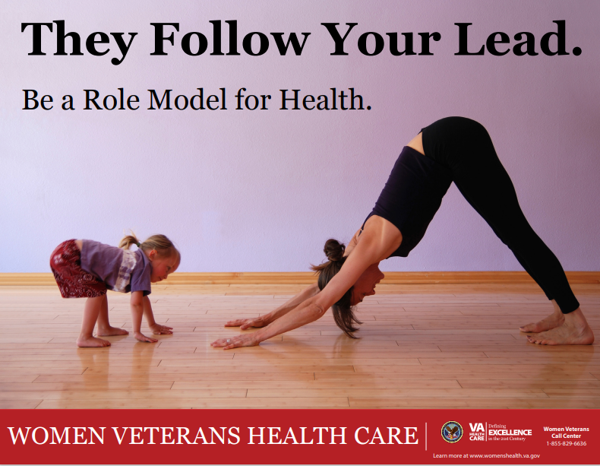
Care in the Community and Care Coordination
VHA coordinates care that is not available within current wait times/access standards or its not provided at the VA Medical Center
Women Veterans have historically been the biggest consumers of care in the community
Care Coordinators utilized to facilitate access to timely and follow-up care

Slide 6
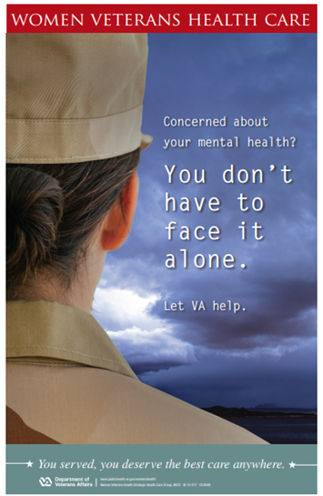
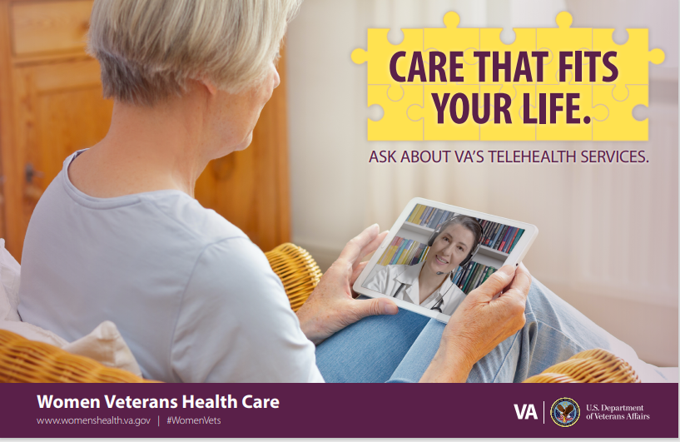
Telehealth Services
Video Teleconferencing
Video on Demand (VOD)
Telephone
Tele-Pharmacy
Tele-Pride
Tele-Mental Health
Gender Specific
  Chronic Pain
  Chronic Disease Mgt
  MST Trauma Education
  Tele MOVE
  Tele Genomics
  Tele GYN
  Tele Maternity

Slide 7

VISN 6 - Clinical Contact Center
Regional contact center with staff to answer calls for all Facilities within VISN 6
Reached by: Calling your local facility and pressing 2 for a Primary care appointment or pressing 3 to speak to a nurse
Scheduling & Administrative support to make, reschedule and cancel Primary Care appointments and receive additional information about VA services
Clinical Triage to talk to an RN and discuss symptoms, concerns, and receive recommendations for health care needs
Virtual Clinic Visits to talk to providers by phone or video to discuss healthcare needs in detail
Pharmacy Support to refill and renew prescriptions and ask medication-related questions
  1.8 Million calls answered since inception in 2022. (564,497 since the beginning of this FY.)
  Currently staffed with 45 triage nurses and 163 AMSA’s (and growing) located in North Carolina and Virginia

Slide 8
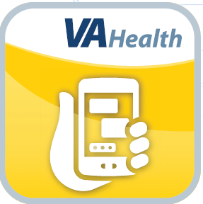
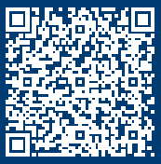
Connect With
VA Care Through VA Health Chat
Receive care from VA without stepping foot into a clinic or hospital.
The VA Health Chat app provides easy, online access to chat with VA staff when you need to schedule a Primary Care appointment refill a medication or speak with a nurse
VA team members are available to chat Monday through Friday from 8:00 a.m. to 4:00 p.m. local time, excluding federal holidays
Learn more about VA Health Chat View the list of participating locations at mobile.va.gov/app/va-health-chat
How to use:
1. Download the App at https://mobile.va.gov/app/va-health-chat.
2. Log in with your username and password for MyHealtheVet, ID.me, or DSLogon.
3. Select ‘V6 Chat with a Nurse’ or ‘V6 Chat with a Scheduler.’
4. Answer a few questions and then start chatting with a nurse or a scheduler to get help!
5. Once you finish your chat, the Nurse or Scheduler with add the chat to your patient notes.
Check out this video to learn more: https://www.youtube.com/watch?v=Wi0xYi7Pgt4

Slide 9


Whole Health Services
Mindfulness Classes
Yoga
Tai Chi
Healthy Cooking
Creative Writing
Creative Arts

Slide 10
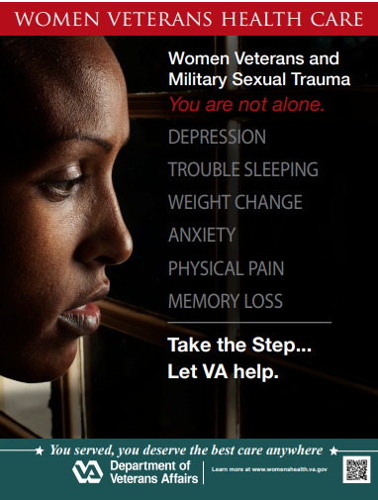

Behavioral Health Services
Women’s Health-Mental Health Champion
Gender Specific support groups and programming
Post Traumatic Stress Disorder (PTSD) groups
Military Sexual Trauma
Suicide Prevention
Individual Counseling
Spiritual Counseling
Reproductive Mental Health
Eating Disorders
Substance Use Disorders

Slide 11
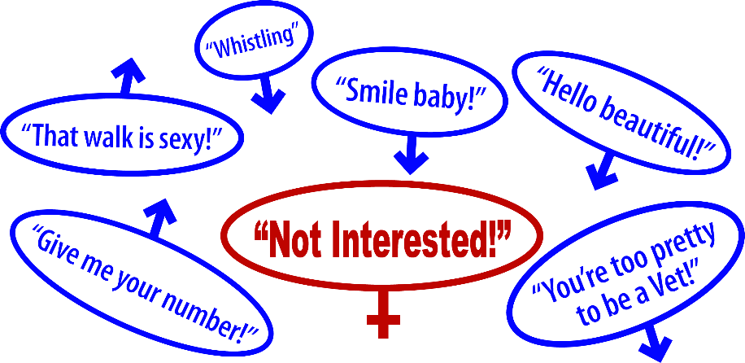

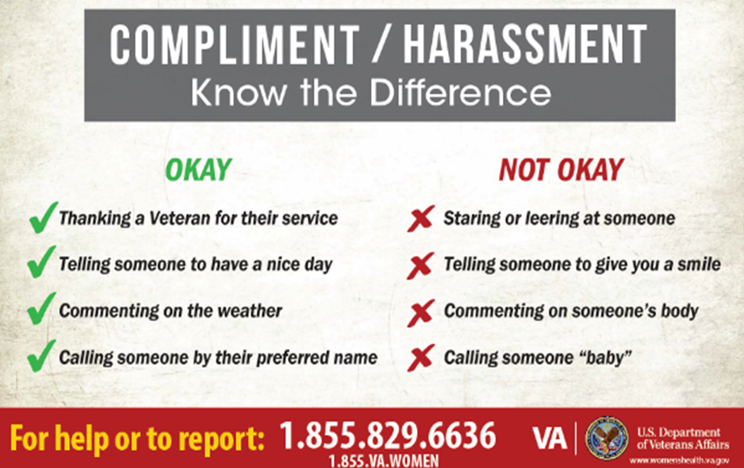
End Harassment Campaign
As part of culture change efforts, VHA is taking a stand against harassment at VA sites of care.
Creating awareness and identifying intervention strategies is the first step.

Slide 12


Privacy and Respect for All Veterans
All Veterans will be treated with respect regardless of:
  Sexual orientation
  Sexual behavior
  Appearance
  Surgical history
All Veterans will be addressed in accordance with each person’s self-identified gender and preferred pronoun

Slide 13
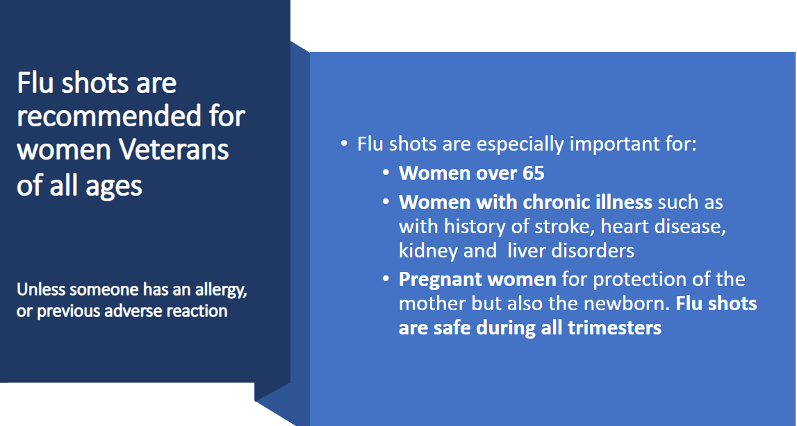

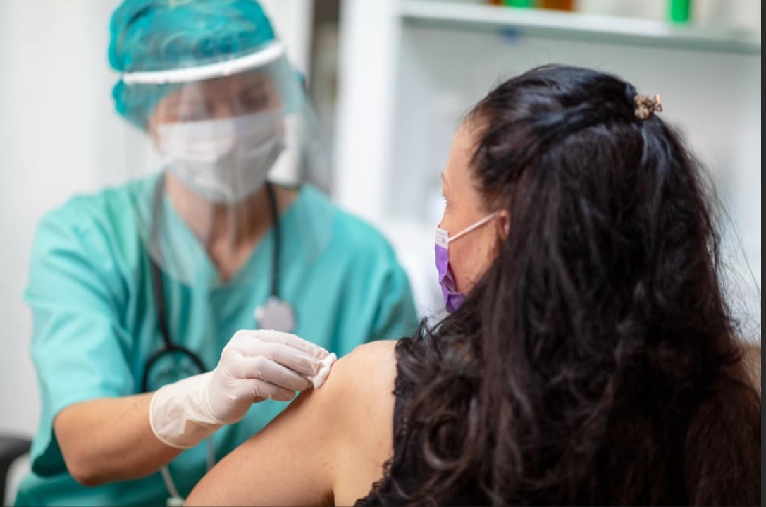
COVID-19, Flu, Shingles Vaccinations Are Available at Your VA Facility!

Slide 14

Women’s Health Program Contact Information
Women Veteran Program Managers (WVPM) – Each VA medical center has a WVPM who is an advocate for Women Veterans
  Asheville VAMC: Sharon West 828-298-7911
  Durham VAMC: Jamie Upchurch 919-286-0411
  Fayetteville VAMC: Yolanda Murphy 910-488-2120
  Hampton VAMC: Catherine McDonald 757-722-9961
  Richmond VAMC: Marlise Skinner 804-675-5000
  Salem VAMC: Melissa Miles 540-982-2463
  Salisbury VAMC: Penny Greer-Link 704-638-9000
  VISN 6 Lead Women Veteran Program Manager: Shenekia
  Williams Johnson 919-956-5541

Slide 15
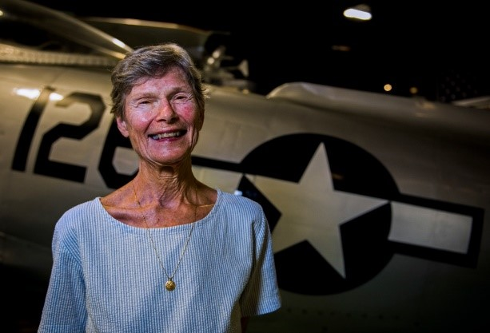
VHA Eligibility and Enrollment
If you served honorably, you may be eligible for VA health care benefits.
You do not have to have a service-connected injury or disability.
All Veterans, including National Guard and Reserves, may be eligible even if they never deployed to a combat zone. Learn more about eligibility criteria: https://www.womenshealth.va.gov/eligibility.asp
Military sexual trauma (MST) is sexual assault or sexual harassment experienced during military service.
  You can receive MST-related care even if you are not eligible for other VA care or are not enrolled in benefits.
  You can receive this care even if you never reported the incident and have no proof that it happened.
You can apply for VA health care benefits by completing the VA Form 10-10EZ and submitting it by mail, phone, in person, or online.
  Online at https://www.va.gov/health-care/apply/application/introduction
  By phone at 877-222-8387 (press 1), Monday through Friday 8:00 a.m. to 8:00 p.m. ET
  In person at your local VA which you can find using this locator tool
  By mail by sending it to the Health Eligibility Center 2957 Clairmont Road, Suite 200, Atlanta, GA 30329
After you apply, you can check the status of your application by calling 877-222-8387 (press 2) starting 1 week after you’ve submitted your application.

Slide 16
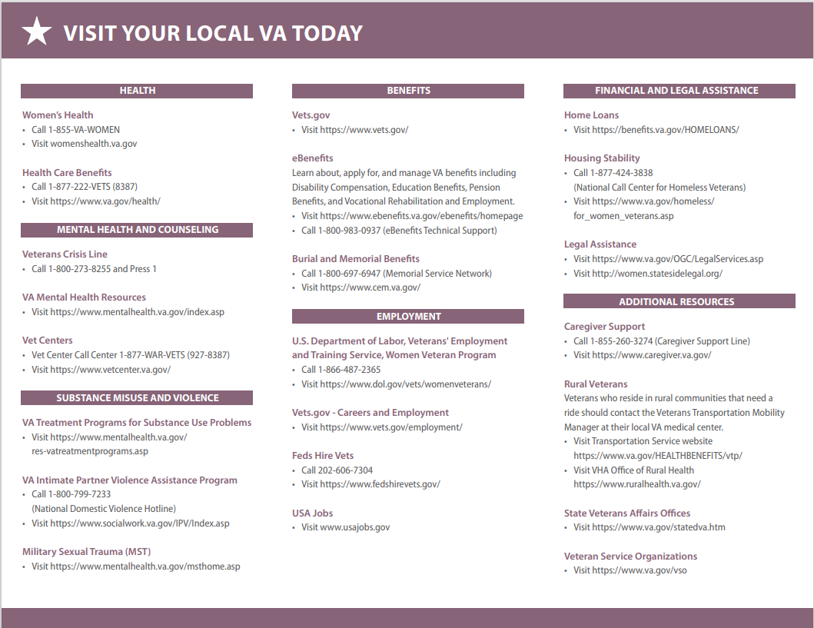
Additional Department of Veterans Affairs Resources

