Slide 1
Women’s Mental Health
Kelly Caron, PhD
Women’s Health - Mental Health Director
Durham VA Medical Center – Durham, NC

Slide 2
Women’s Mental Healthcare: Overview
Services Available
  Psychotherapy
  Psychiatry/Medication Management
  Adjunctive Services (e.g., Chaplain, Peer Support, Occupational Therapy)
Common Presentations
  Post-Traumatic Stress Disorder
  Depression
  Substance Use
Eligibility

Slide 3
Women’s Mental Healthcare: Accessing Care
How do I know when to come in for care?
  Medical model can create an emphasis on addressing symptoms
  Recovery model of care emphasizes importance of impairment of symptoms
    Does your behavior/symptom/set of thoughts get in the way of you doing the things most important?
Levels of Care
  Primary Care – Mental Health Integration
  Continuity Care in a Behavioral Health Interdisciplinary Program (BHIP)
  Specialized Outpatient Care (e.g., Trauma Recovery, Substance Use Treatment, etc.)
  Inpatient or Residential Care
  Self-Care!
Notes:
Example of recovery model of care and how it addresses Depressed mood vs. Major Depressive Disorder vs. temporary increases in stress

Slide 4
Questions?
Questions about Women’s Mental Health?
Up Next: Mindfulness

Slide 5
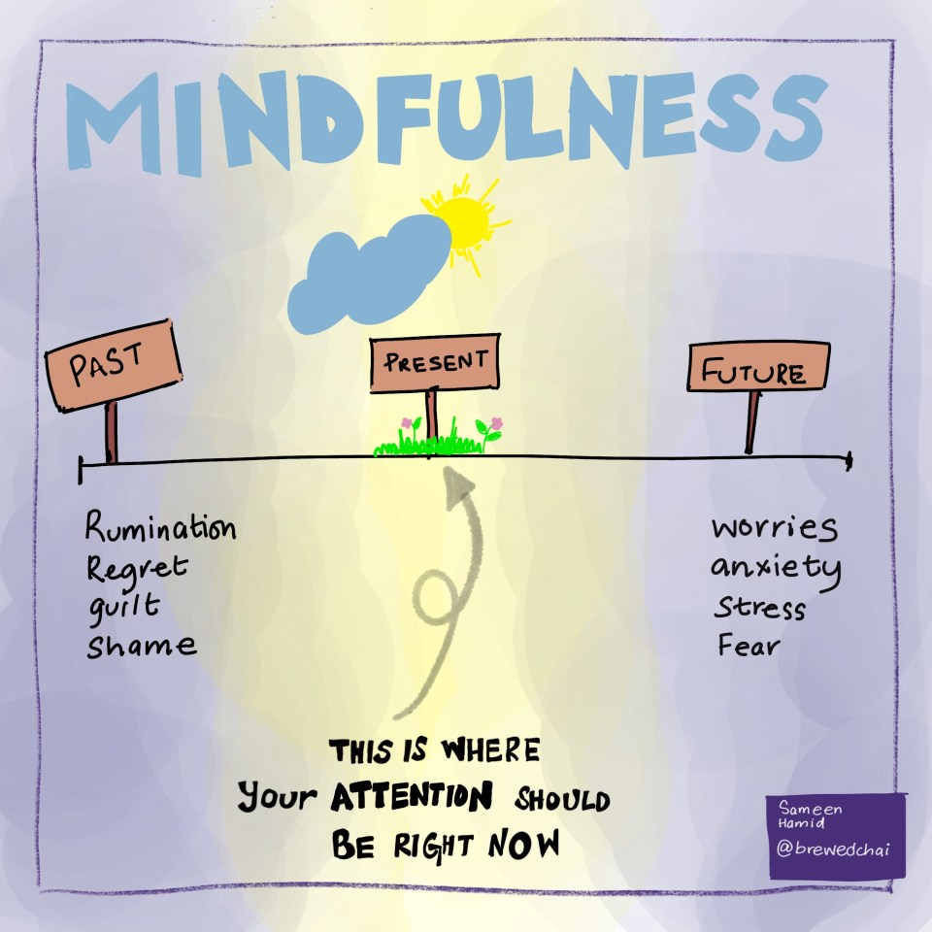
Mindfulness
Mindfulness involves an attentional focus on the present moment
Regular mindfulness practice can improve anxiety, depression, sleep and even physical health!
Mindfulness is:
  Intentional
  Nonjudgmental
Notes:
Explain how mindfulness and mindfulness practice are different.

Slide 6
Mindfulness
Mindfulness can be challenging and takes practice
Practice by observing and describing your experience in the present moment
When we are more mindful, we make decisions and choose action that is more in line with our own values and personal wisdom
Let’s practice together!
Notes:
Mindfulness is like a muscle we must train

Slide 7
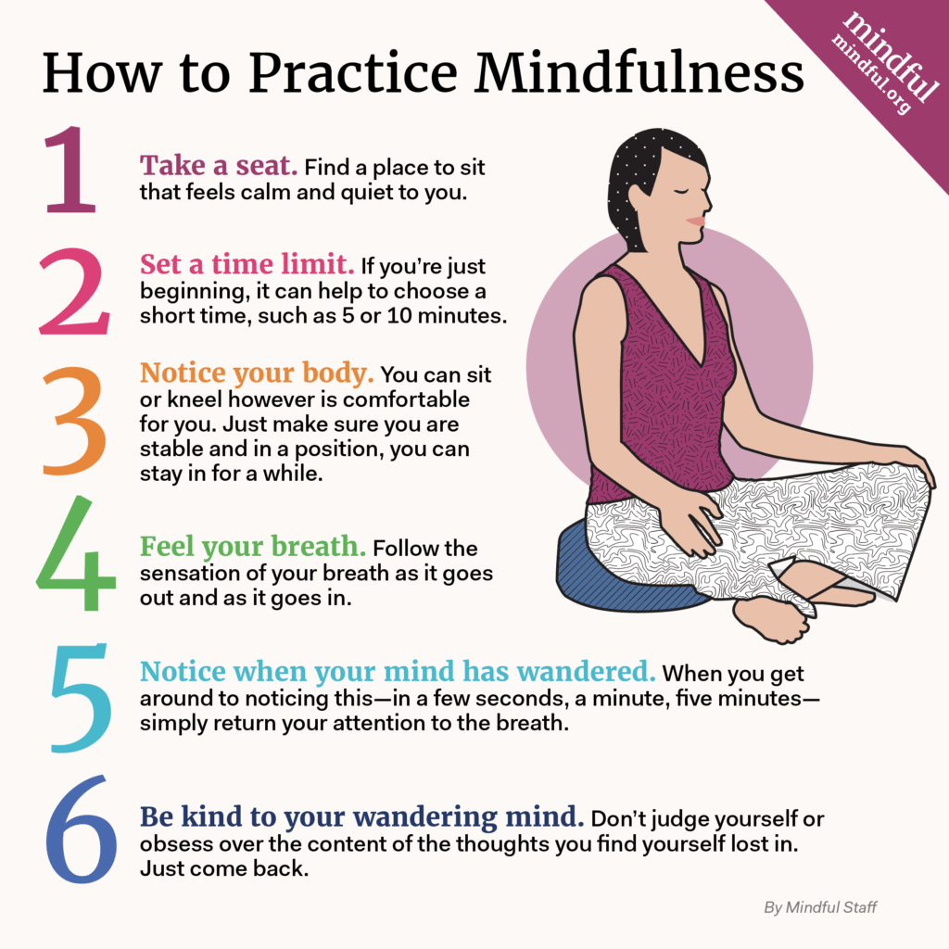
Mindful Breathing

Slide 8
Ways to Cope: Virtual Resources
VA apps – www.mobile.va.gov/Appstore
  Mindfulness Coach – with audio files to support mindfulness practice
  Beyond MST – for survivors of Military Sexual Trauma
  PTSD Coach – Information and strategies to help you manage symptoms of PTSD
  Stay Quit Coach – to help you quit smoking
Non-VA resources:
  Virtual Hope Box – found through the App Store
  RAINN (https://hotline.rainn.org/online) has a 24/7 hotline (call or chat) for sexual assault survivors
  The National Domestic Violence Hotline (https://thehotline.org) can be accessed via phone/web/text
Get Connected! If you’re more isolated these days, look for well-established, online communities that can support you
  National Alliance on Mental Health (https://www.nami.org) has numerous local support groups
  Postpartum Support International (https://www.postpartum.net) has a Military Moms Group

